Slide 1
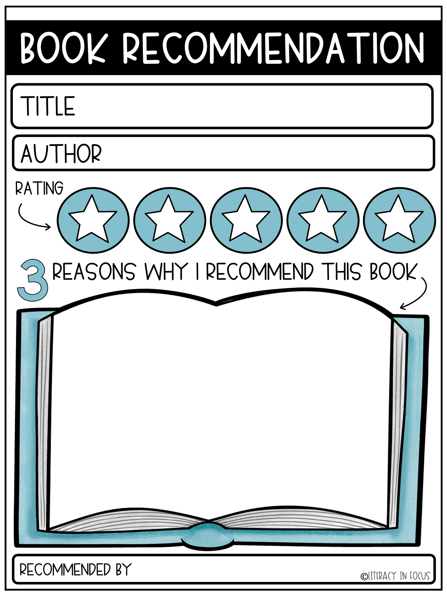
Drag and drop the gold stars to give your book a rating.

